Slide 1
ANGULAR DETAILS
INTRODUCTION AND BASICS
By
Sandip

Slide 2
What is Angular?
Angular is a JavaScript framework to build more interactive web applications.
It is designed for both Web, Desktop and Mobile platforms.
Angular is the next version of most successful AngularJS 1.x, which was released in 2010.
Angular was completely rewritten from scratch in TypeScript, which is superset of JavaScript.
Angular was finally released on 14th Sep, 2016. It is called Angular or Angular 2.
Angular 4 was released in March, 2017 and there was no Angular 3.
Angular 5 was released in Nov, 2017.
Angular 6 was released in May, 2018.
Angular 7 was released in Oct, 2018.
Angular 8 was released in May, 2019.
Angular 9 was released in Feb, 2020.
It has been optimized for developer productivity, small payload size, and performance.
Developed using TypeScript, which is Microsoft’s extension of JavaScript that allows use of all ES 2015
(ECMAScript 6) features and adds type checking and object-oriented features like interfaces.
You can write code in either JavaScript or TypeScript or Dart.

Slide 3
Setting Up Development Environment
Install Node.js and NPM
Install Angular CLI
Install Visual Studio Code or Similar IDE
Create a new project using Angular CLI
Open project folder in Visual Studio Code
Start server using NodeJS

Slide 4
Installing Node.JS and NPM
Node.js is used to run JavaScript on server and provide environment for build tools.
NPM is used to manage packages related to JavaScript libraries.
NPM itself is a Node application.
To install, go to https://nodejs.org/en/download and download installer (.msi) for 32-bit or 64-bit.
Run .MSI file to install Node.js into your system. It is typically installed into c:\Program Files\nodejs folder.
It installs Node.js and NPM.
It also sets system path to include Node and NPM.
Go to command prompt and check their versions using following commands in console.
> node -v
> npm -v

Slide 5
Installing Angular CLI
Angular CLI - Command Line Interface for Angular Applications.
It needs Node 6.9.x or higher, together with NPM 3.x.x or higher.
Install Angular CLI using NPM as follows:
> npm install -g @angular/cli

Slide 6
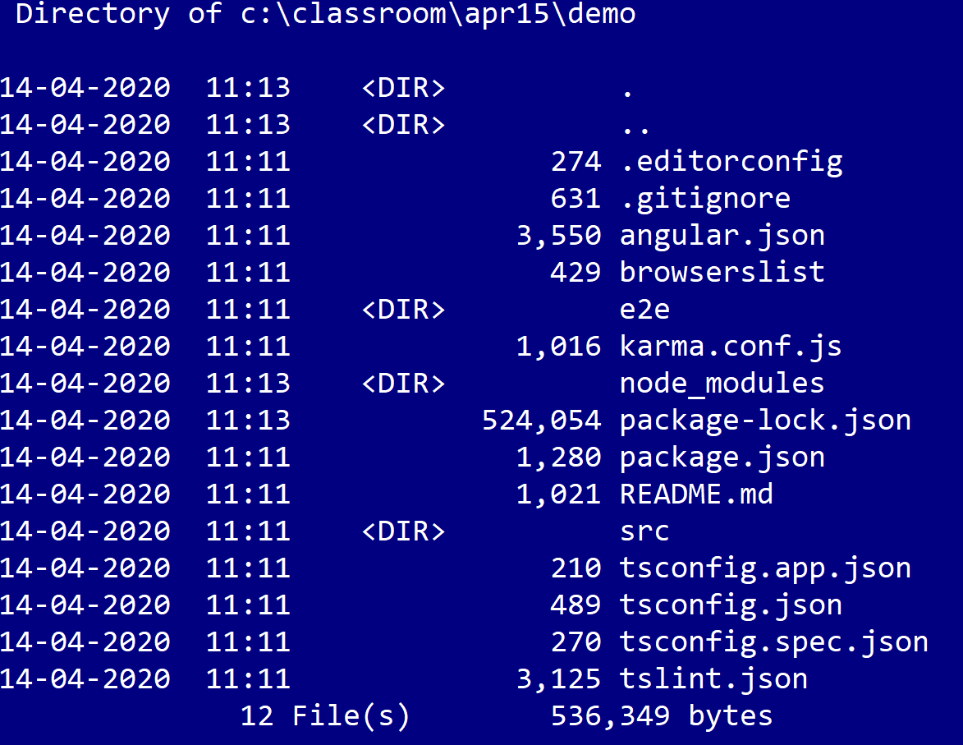
Using Angular CLI
Give the following command in console to create a new Angular Project. It creates the following directory structure:
ng new demo

Slide 7
Usage of Angular CLI
Scaffold | Usage
Component | ng g component my-new-component
Directive | ng g directive my-new-directive
Pipe | ng g pipe my-new-pipe
Service | ng g service my-new-service
Class | ng g class my-new-class
Guard | ng g guard my-new-guard
Interface | ng g interface my-new-interface
Enum | ng g enum my-new-enum
Module | ng g module my-module

Slide 8
Start Server
While in project folder (first), enter the following command to start server.
Server watches your files and rebuilds app whenever you make changes to files in folder.
ng serve
Go to browser and navigate to following URL:
http://localhost:4200
It is possible to start server on a different port number than default (4200) as follows:
ng serve –port 3000

Slide 9
Important files in project folder
app/app.module.ts
Defines AppModule, the root module that tells Angular how to assemble the application. Right now it declares only
the AppComponent.
app/app.component.{ts,html,css,spec.ts}
Defines the AppComponent along with an HTML template, CSS stylesheet, and a unit test. It is the root component
of what will become a tree of nested components as the application evolves.
index.html
The main HTML page that is served when someone visits your site. Most of the time you'll never need to edit it. The CLI automatically adds all js and css files when building your app, so you never need to add any script or link tags here manually.
main.ts
The main entry point for your app. Compiles the application with the JIT compiler and bootstraps the application's
root module (AppModule) to run in the browser.

Slide 10
Building Blocks
Modules
Components
Templates
Metadata
Data binding
Directives
Services
Dependency injection

Slide 11
Module
A module is a class that is decorated with @NgModule decorator.
Every application contains at least one module called root module, conventionally called as AppModule.
NgModule decorator provides information about module using properties listed below:
Declaration – Classes that belong to this module. They may be components, directives and pipes.
Exports – The subset of declarations that should be visible to other modules.
Imports – Specifies modules whose exported classes are needed in this module.
Bootstrap – Specifies the main application view – root component. It is the base for the rest of the application.

Slide 12
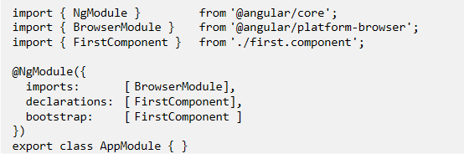
Module

Slide 13
Angular Module vs. JavaScript Module
A module in Angular is a class decorated with @NgModule decorator.
Whereas a module in JavaScript is a file and all objects defined in the file belong to that module.
JavaScript module exports some objects using export keyword and they can be imported in other modules
using import statement.
Angular ships a couple of JavaScript modules each beginning with @angular prefix.
In order to use objects in those modules, we need to import them using import statement in JavaScript.
import { Component } from '@angular/core';
import { BrowserModule } from '@angular/platform-browser';

Slide 14
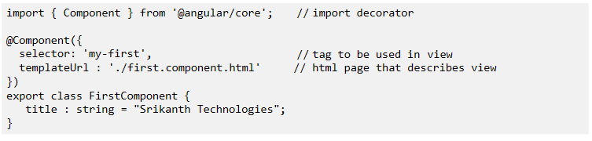
Component
A component controls a part of the screen called view.
Every component is a class with its own data and code.
A component may depend on services that are injected using dependency injection.
The template, metadata, and component together describe a view.
Components are decorated with @Component decorator through which we specify template, styles and
selector (tag) related to component.
Properties like templateUrl, styleUrl and providers can also be used.

Slide 15
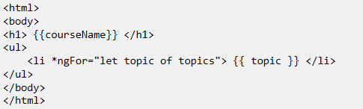
T emplate
Component's view is defined with its companion template.
A template is in the form of HTML that tells Angular how to render the component.
Template is the user interface (UI) of component.
Template can use the following:
HTML
Interpolation {{ …}}
Structural and Attribute directives
Data binding
Template reference variables
Pipes

Slide 16
Interpolation
When you put properties in view template using {{ }}, it is called interpolation.
Angular updates the display whenever property changes.
The context of the expression is component instance that is associated with the view.
The expression is evaluated, converted to string and then sent to client.
From the expression, we can call methods of component associated with view.
The target of the template expression may be HTML element, a component, or a directive.
In case of assigning value to a property, template expression may appear in double quotes.
<span [hidden]="isNew">Modified</span>
<img src="{{filename}}" />

Slide 17
Template Statement
A template statement responds to an event raised by a binding target such as an element, component, or
directive.
The template statement parser differs from the template expression parser and specifically supports both basic assignment (=) and chaining expressions (with ; or ,).
Template statements cannot refer to anything in the global namespace. They can NOT refer
to window or document. They cannot call console.log or Math.max.
The following expressions of JavaScript are NOT allowed:
new
increment and decrement operators, ++ and --
operator assignment, such as += and -=
the bitwise operators | and &
the template expression operators
<button (click)="calculate()">Calculate</button>
<button (click)="onSave($event)">Save</button>

Slide 18
Data Binding
Data binding allows copying values from Component properties to attributes of HTML elements.
Following are different bindings available :
Property Binding
Event Binding
Attribute binding
Class binding
Style binding

Slide 19
Property Binding
Binds value to a property in HTML element or Angular Component.
Target property must be a property and not just an attribute in DOM element.
{{expression}} [targetproperty]="expression" bind-targetproperty="expression"
<img [src]="heroImageUrl">
<img bind-src="heroImageUrl">
<img src="{{imageUrl}}">

Slide 20
HTML Attribute vs. DOM Property
Attributes are defined by HTML.
Properties are defined by the DOM (Document Object Model).
A few HTML attributes have 1:1 mapping to properties. Example: id
Some HTML attributes don't have corresponding properties. Example: colspan
Some DOM properties don't have corresponding attributes. Example: innerHTML
Value of property might change at runtime but value of attribute doesn’t change. Example: value
Angular Property Binding deals with DOM properties and not HTML attributes

Slide 21
Attribute Binding
Sets the value of an attribute directly.
Must be used when there is no element property to bind.
Attribute binding syntax resembles property binding.
Start with the prefix attr, followed by a dot (.) and the name of the attribute.
You then set the attribute value, using an expression that resolves to a string.
<td [attr.colspan]="noCols">Value</td>
Angular Expression

Slide 22
Class Binding
Adds or removes CSS class names from element's class attribute.
Class binding syntax resembles property binding.
Instead of an element property between brackets, start with the prefix class, optionally followed by a dot (.) and the name of a CSS class - [class.classname].
Angular adds the class when the template expression evaluates to true. It removes the class when the expression is false.
NgClass directive is usually preferred when managing multiple class names at the same time.
<div [class.special]="isSpecial">Special Offer</div>
Angular Expression

Slide 23
Style Binding
Sets inline styles.
Instead of an element property between brackets, start with the prefix style, followed by a dot (.) and the
name of a CSS style property: [style.style-property].
NgStyle directive is usually preferred when setting multiple styles at the same time.
<button [style.color]="isSpecial ? 'red': 'green'">Show Details</button>
<button [style.background-color]="canSave ? 'cyan': 'grey'">Save</button>

Slide 24
Event Binding
Event binding syntax consists of a target event name within parentheses on the left of an equal sign, and a
quoted template statement on the right.
The binding conveys information about the event, including data values, through an event object named $event.
If the name fails to match an element event, Angular reports an error.
<button (click)="onSave()">Save</button>
<button on-click="onSave()">Save</button>

Slide 25
Attribute Directives
These attributes are used like attributes of HTML elements.
They modify the behavior of HTML elements.
ngClass | Add and remove a set of CSS classes
ngStyle | Add and remove a set of HTML styles
ngModel | Two-way data binding to an HTML form element

Slide 26
ngClass Directive
Used to add or remove many CSS classes at the same time.
Bind ngClass to a key:value object where each key of the object is a CSS class name; its value is true if the
class should be added, false if it should be removed.
currentClasses = {"special" : true, "big" : true};
<div [ngClass]="currentClasses"> … </div>

Slide 27
ngStyle Directive
Used to set many inline styles at the same time.
Bind ngStyle to a key:value control object where each key of the object is a style name and its value is whatever
is appropriate for that style.
brightRed = {"color" : "red", "font-size" : "30pt"};
<div [ngStyle]="brightRed">Some Text Here!</div>

Slide 28
Structural Directives
These directives are responsible for HTML layout.
They typically add, remove, and manipulate the host elements to which they are attached.
ngIf | Conditionally adds or removes an element from DOM
ngFor | Repeats a template for each item in the list
ngSwitch | Adds one element from a set of possible elements based on condition. Used with ngSwitchCase and ngSwitchDefault

Slide 29
ngIf Directive
Conditionally adds or removes an element from the DOM.
Adding and removing DOM elements is different from displaying and hiding element.
It is possible to have if then else structure with true block and false block using ng-template.
<div *ngIf="condition">Add Div to DOM when condition is true </div>
<div *ngIf="condition; else falseBlock">True Block</div>
<ng-template #falseBlock><div>False Block</div></ng-template>
<div *ngIf="condition; then trueBlock; else falseBlock"></div>
<ng-template #trueBlock><div>True Block</div></ng-template>
<ng-template #falseBlock><div>False Block</div></ng-template>

Slide 30
ngFor Directive
Repeats a template for each item in the given list.
NgFor is a repeater directive — a way to present a list of items. You define a block of HTML that defines how a single item should be displayed.
It provides some exported values that can be assigned to local variables.
index | The index of the current item in the list. It is a number
first | True if item is first item in the list
last | True if item is last item in the list
even | True if item has even index
odd | True if item has odd index

Slide 31
ngFor Directive
<div *ngFor="let topic of topics; let i=index; let first=first;let oddRow=odd">
<h2 *ngIf="first">List Of Topics</h2>
<span [class.red]="oddRow">
{{i + 1}} - {{topic}}
</span>
</div>

Slide 32
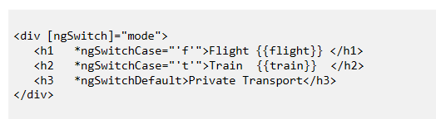
ngSwitch Directive
It is like the JavaScript switch statement.
It can display one element from among several possible elements, based on a switch condition.
Angular puts only the selected element into the DOM.
NgSwitch is actually a set of three, cooperating directives: NgSwitch, NgSwitchCase, and NgSwitchDefault.

Slide 33
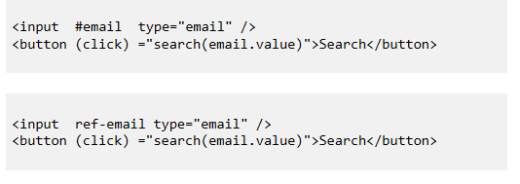
Template Reference Variable (#var)
A template reference variable is often a reference to a DOM element within a template.
It can also be a reference to an Angular component or directive.
Use the hash symbol (#) to declare a reference variable.
You can refer to a template reference variable anywhere in the template.
The scope of a reference variable is the entire template.
You can use the ref- prefix alternative to #.

Slide 34
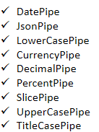
Pipes
A pipe takes data as input and transforms it to required output.
Angular provides built-in pipes for many common requirements.
Pipes are used in template.
Pipes can also take optional parameters to fine tune output.
To add parameters to a pipe, follow the pipe name with a colon ( : ) and then the parameter value (such as
currency : 'EUR').
If the pipe accepts multiple parameters, separate the values with colons (such as slice:1:5).
You can chain pipes together so that output of one pipe goes to another pipe as input.

Slide 35
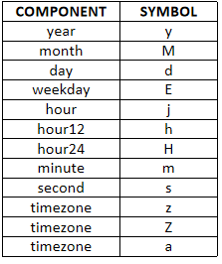
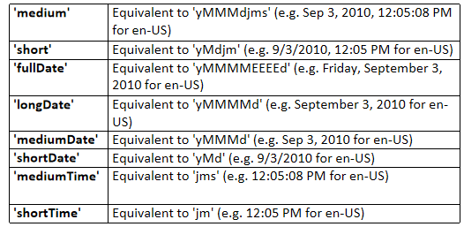
DatePipe
Formats a date according to locale rules.
date_expression | date [:format]

Slide 36
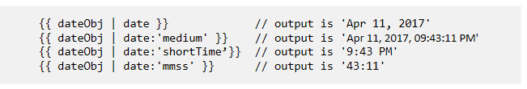
DatePipe - Example

Slide 37
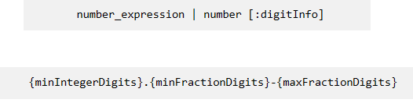
DecimalPipe
minIntegerDigits
Is the minimum number of integer digits to use. Defaults to 1.
minFractionDigits
Is the minimum number of digits after fraction. Defaults to 0.
maxFractionDigits
Is the maximum number of digits after fraction. Defaults to 3.

Slide 38
CurrencyPipe
Formats a number as currency using locale rules.
currencyCode
Is the currency code, such as USD for the US dollar and EUR for the euro.
symbolDisplay
Is a boolean indicating whether to use the currency symbol or code - true: use symbol (e.g. $), false(default): use code (e.g. USD).

Slide 39
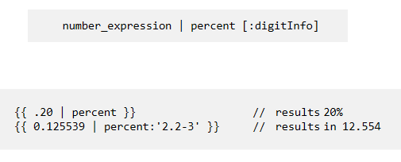
PercentPipe
Formats a number as a percentage.

Slide 40

SlicePipe
Creates a new List or String containing a subset (slice) of the elements.
start
The starting index of the subset to return.
end
The ending index of the subset to return.

Slide 41
Custom Pipes
Create a class and decorate it with @Pipe decorator.
The pipe class implements PipeTransform interface's transform method that accepts an input value followed by optional parameters and returns the transformed value.
There will be one additional argument to the transform method for each parameter passed to the pipe.
The @Pipe decorator allows you to define the pipe name that you'll use within template expressions. It must
be a valid JavaScript identifier.
You must include your pipe in the declarations array of the AppModule.

Slide 42
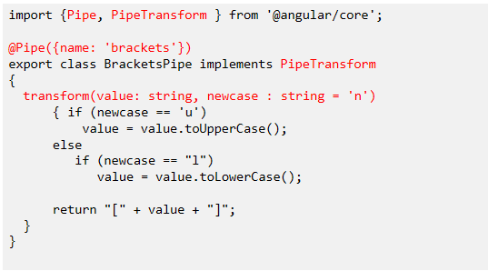
brackets.pipe.ts

Slide 43
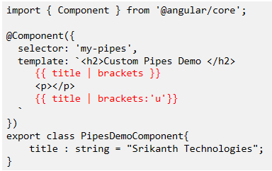
pipesdemo.component.ts

Slide 44
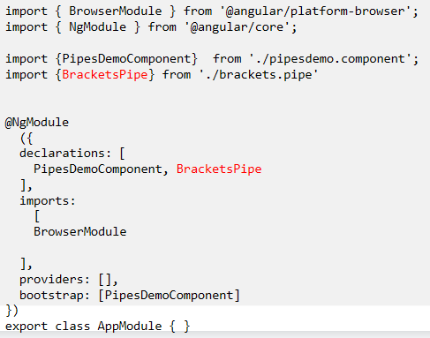
app.module.ts

